Slide 2
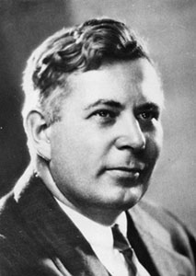
History of DISC
In 1928, a Harvard trained psychologist working at Columbia University, William Moulton Marston, Ph.D. based much of his life work on studying and enhancing his 4 Quadrant model. His book entitled The Emotions of Normal People outlined his theories and became the foundation for modern DISC assessments. Marston introduced the definitions of DISC.
DISC is an acronym for:
Dominance – relating to control, power and assertiveness
Inducement (redefined as Influence) – relating to social situations and communication
Submission (redefined as Steadiness) – relating to patience, persistence, and thoughtfulness
Compliance – relating to structure and organization
DISC theory and assessment tools have stood the test of time, passing validation studies from the most prestigious learning institutes in the world.
William Marston, Ph.D.
Notes:
Read the slide.

Slide 3
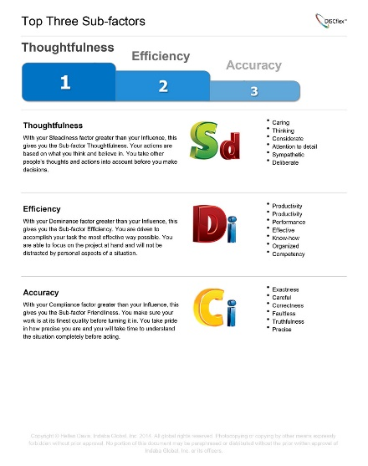
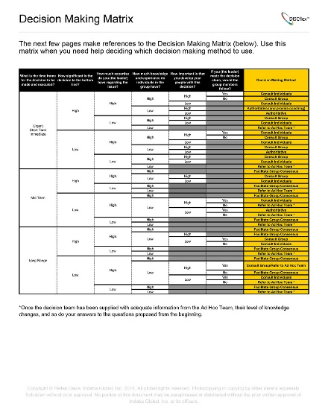
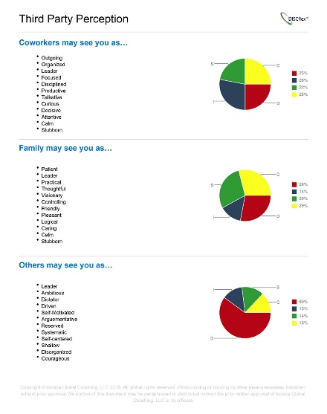
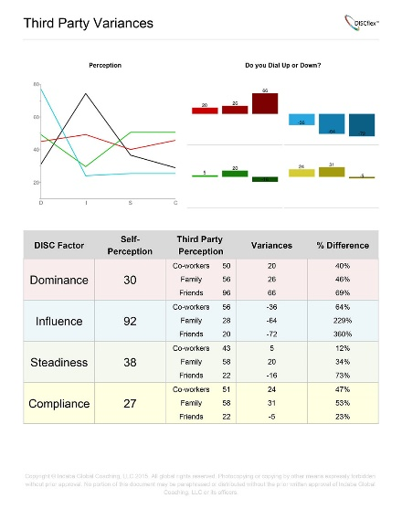
History of DISC
In the past 50 years, dozens of behavioral scientists and assessment companies have been instrumental in reworking the DISC theory and commoditizing Marston’s work. Dr. John Geier bought the rights to Marston's book and created the first DISC Assessment in 1958.
DISCflex has further revolutionized the assessment industry. Our DISCflex products leverage our extensive corporate and public sector expertise as well as our accomplishments in the executive coaching, training, media, production development, and personal improvement business.
How is DISCflex different?
Whereas DISC was focused solely on self-perception, DISCflex products incorporate 3rd Party perception, and answer the question that participants consistently ask after they read through their DISC report: "Now what?"
Designed to provide a complete guide to understanding and changing your behaviors. Results are based on a participant’s set of questions and word selections and targeted eLearning is delivered to enable an individual to become “a Chameleon on a Rainbow”.
Notes:
Read the slide.

Slide 4
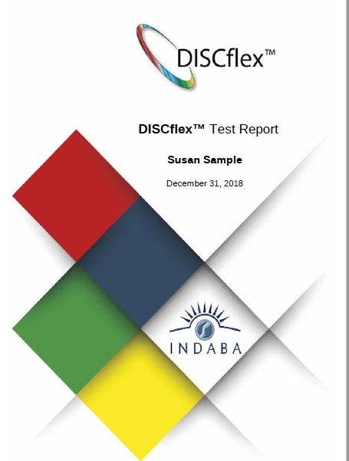
Indaba’s Version of DISC
Allows the participant to understand and learn how to:
‘Dial-up' and 'dial-down' behavior tendencies
Determine when to use short-term 'situational behavioral flexing'
Use 'behavioral shifts' to their benefit
Allows for identification and solidification of long-term 'behavioral morphing‘
Provides participants with the tools, knowledge and information to expand their horizons. Participants learn to avoid pigeon-holing and understand their own natural behavioral preferences.
Especially useful in understanding the possible stressors within ourselves, inside teams, and as part of our environment.
Which program is best suited for you?
Interviewing potential employees – Hiring
Executives - Leadership
Managers/Employees - Business Behaviors
Notes:
Read the slide.

Slide 5
Report Walk Thru

Slide 6
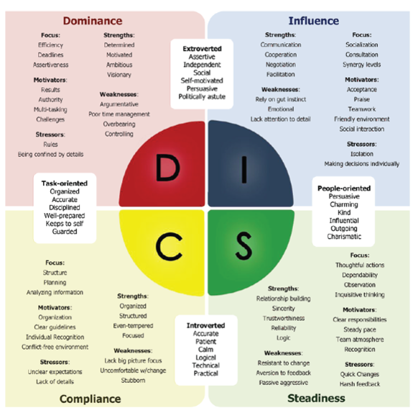
Defining DISC
What is a DISC Assessment?
A DISC Assessment is not a test, so it is impossible to fail. So what does a DISC assessment measure? DISC assessments measure your different levels of each of the four DISC Factors:
Dominance: Your need for control and your source of ambition. Whenever you are feeling self-motivated, you are using your 'D' factor.
Influence: Your need for communication and your source of persuasion. Whenever you are feeling talkative, you are using your 'I' factor.
Steadiness: Your need for planning and your source of thoughtfulness. When you are being strategic or go out of your way to help someone, you are using your 'S' factor.
Compliance: Your need for structure and your source of organization. When you become extremely focused on completing your tasks, you are using your 'C' factor.
Notes:
Read the slide.

Slide 7
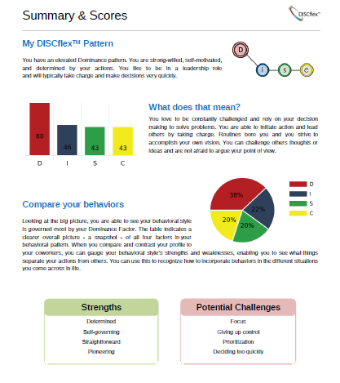
Summary & Scores Page
Notes:
The summary and scores page is the first page of the report that is personalized to you and displays your DISC results.

Slide 8
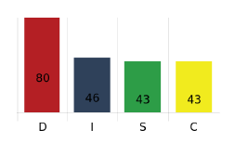
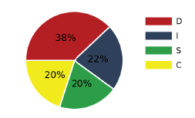
Assessment Results
DISC Pattern
Bar Graph
Pie Chart
There are 15 DISCflex Patterns. You can have one elevated factor, multiple, or even a flat line with no elevated factor. Each pattern has general characteristics associated with it.
For Example: An “Elevated D Pattern” (as above) would prefer to be in control of a situation and would be highly self-motivated in most situations.
The Bar Graph shows the exact scores for an individual from 0 to 100 for all 4 factors. The higher the score the higher the likelihood the individual will display this factor’s tendencies.
For Example: This individual is highly likely (80) to display Dominance tendencies and least likely (43) to display Influence and Steadiness tendencies.
The Pie Chart shows the Percent to total of each of the 4 factors. The higher the percent the higher the likelihood the individual will display this factor’s tendencies.
For Example: This individual is highly likely (38%) to display Dominance tendencies and least likely (20%) to display Influence and Steadiness tendencies
Notes:
Notes - Just because you have a Low I or S Factor score does not mean that it is not part of who you are. Each person has each factor in them and can use that factor.

Slide 9
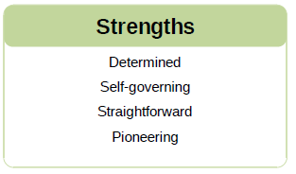
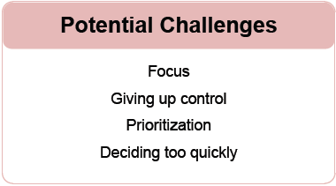
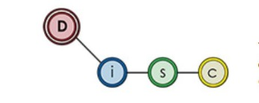
Strengths and challenges
Each person has their own Strengths and Potential Challenges.
D-
I-
S-
C-
Notes:
Strengths come from the individual factor scores.
Challenges come from the DISCflex pattern.
The challenges will only focus on the elevated factor(s) in your pattern, so if you forget to use those other factors then you can run into problems. Our hopes are you can use this to overcome these challenges, and you may find a couple you already have.

Slide 10
Motivators and Stressors
Notes:
The motivators and stressors page is personalized to your DISC results.

Slide 11
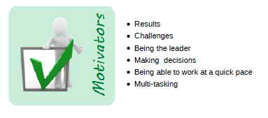
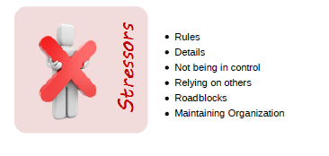
Motivators and stressors
Each person has their own Motivators and Stressors based on their DISC results.
Motivators:
Ready to get motivated? We’ve highlighted some key things that get your blood pumping. You will find that some of these motivators happen on an unconscious level. Use these to explore other motivators you have within yourself and that guide you to certain decisions and actions.
Stressors:
When you get angry or frustrated, it’s due to one of your stressors. This list provides some of the deeper stress factors that happen in your brain and cause you to act in a negative manner. When you let your stressors get to you, always know that you are at risk of causing conflict within yourself and your relationships with others.
D-
D-
I-
I-
S-
S-
C-
C-
Notes:
The first two bullet points (inside the red box) for both motivators and stressors relate to the individual’s DISC Pattern. While the bottom four bullet points pull from the individual factor scores.

Slide 12
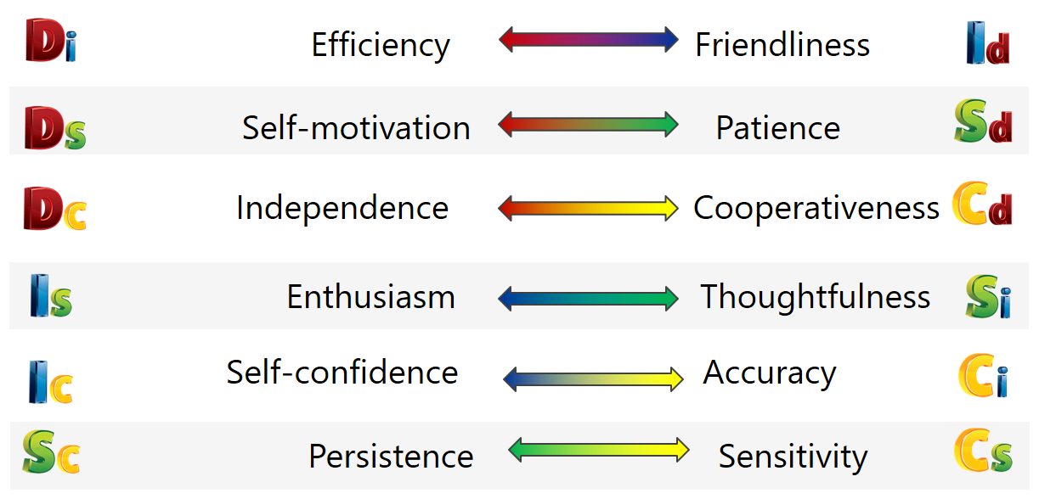
Sub-Factors
Notes:
This section dives into the difference between individual DISC factor scores and how they compare to one another. When one factor is displayed above another you get what we call a sub-factor. There are 12 sub-factors that create 6 spectrums. Based on your DISC results we know which side of the spectrum you will naturally tend to lean towards.

Slide 13
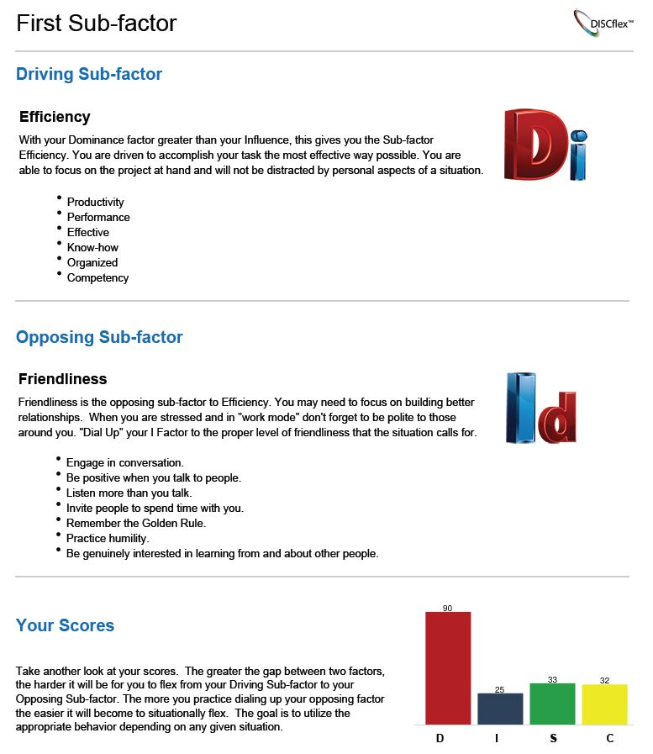
Sub-Factors
Driving Sub-factor- Your natural behavioral tendencies. When used properly these natural tendencies can provide great results, but be careful not to dominate your opposing sub-factor. Be aware of the situation and "dial" your behavior to match it.
Opposing Sub-factor- the behavioral tendencies you naturally use the least. These are tendencies you need to consciously focus on "dialing up". Be aware of the situation and "dial" your behavior to match it.
Notes:
Read slide.

Slide 14
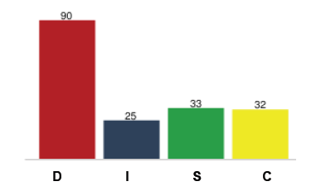
Sub-Factor Example
The report provides your Top 3 Sub-Factors by analyzing your three biggest gaps between DISC factors.
To the right you will see that in this example, the person’s Dominance score is 90 and their Influence score is 25.
This 65 point (very large) gap means they will rely heavily on their Driving Sub-factor (efficiency) over their Opposing Sub-factor (friendliness).
Both Efficiency and Friendliness are great when used properly and have their faults when used at the wrong time. This page will give tips on how to “Dial Up” Friendliness when the situation calls for a more “people-oriented approach”
Notes:
Read slide.

Slide 15
DISC Sub-factors™
Efficiency
Friendliness
When Dominance is greater than Influence, you have the…
Efficiency Sub-factor™
Up
When Influence is greater than Dominance, you have the…
Friendliness Sub-factor™
Up
+50
Rushed
Tunnel Vision
Efficient
Laser Focused
Direct
Assertive
Performance Driven
Productive
Effective Communication
Inclusive
Social
Accepting
Kind
Friendly
Passive Leadership
Insecurity
+40
High D
Low I
+30
+20
+10
Even
Balanced
Down
+10
+20
Direct and assertive
Finish work very quickly
Rarely or never miss deadlines
May appear willing to do whatever it takes to get the job done
+30
Love communication
Extrovert
Good at making small talk
Get along well with others
High I
Low D
+40
+50
Up
Up
Notes:
***These notes are for preparation and understanding of the slides to follow- It is best to understand these notes and use a shorthand version of these notes for your actual presentation***
Here we are examining the D factor vs the I factor. We refer to this Sub-Factor Spectrum as Efficiency vs Friendliness.
(left side) When someone’s Dominance Score is greater than their Influence Score, they will tend to be more Efficient than Friendly.
(right side) When someone’s Influence Score is greater than their Dominance Score, they will tend to be more Friendly than Efficient.
Both Efficiency and Friendliness are great strengths to use but must be used at the appropriate time.
The bigger the gap between the 2 scores, the more heavily a person will tend to lean on their Driving Sub-Factor and the more energy or focus it will take to shift to their opposing Sub-Factor.
****Click Slide to Highlight grey “balanced” box****
(*middle of screen*) If the 2 factor scores are close to or exactly even then the person is likely to display a good balance between the 2 sub-factors.
Someone who has a good balance between Efficiency and Friendliness will be productive and communicate effectively. It should be relatively easy for this person to shift back and forth between being efficient and friendly.
****Click slide to highlight top (RED) box****
Here we see someone with a High D and Low I (30-40-point gap) would tend to be much more Efficient than Friendly. This person would need to consciously “Dial Up” their Influence (Friendliness) and “Dial Down” their Dominance (Efficiency) in situations that require a more friendly approach. This will initially take a lot of effort, but the more they practice “Dialing Up” their Influence (Friendliness) the easier it will become to shift between the 2 sub-factors and display the appropriate behavior.
****Click to highlight bottom (Blue) box****
Here we see someone with a High I and Low D (30-40-point gap) would tend to be much more Friendly than Efficient. This person would need to consciously “Dial Up” their Dominance (Efficiency) and “Dial Down” their Influence (Friendliness) in situations that require a more Efficient approach. Again, this will initially take a lot of effort, but the more they practice “Dialing Up” their Dominance (Efficiency) the easier it will become to shift between the 2 sub-factors and display the appropriate behavior.
Please note: There is such a thing as Dialing Up “Too high”. As you can see, if we dial up our Dominance too high and move PAST efficiency and become too task oriented, we can become Rushed and have Tunnel Vision. If we Dial Up our Influence too high and focus too much on being People Oriented, we can get to a place of Passive Leadership and Insecurity. The key is to learn how to effectively use both Sub-Factors and identify which is most appropriate for any given situation. Use your Sub-Factor pages from your report to

Slide 16
DISC Sub-factors™
Independence
Cooperativeness
When Dominance is greater than Compliance, you have the…
Independence Sub-factor™
When Compliance is greater than Dominance, you have the…
Cooperativeness Sub-factor™
Up
+50
Rule Breaker
Permission Taker
Independent
Take Charge
Assertive
Self-Reliant
Competitive
Effective
Team Player
Easy Going
Respectful
Compliant
Obedient
Cooperative
Complacent
Submissive
+40
High D
Low C
+30
+20
+10
Even
Balanced
+10
+20
Prefer to work alone
Create their own rules
Typically remain neutral in the affairs of others
Goal-oriented
+30
Easy to work with
Enjoy helping out
Focus on policies and procedures
Naturally build positive relationships with others
High C
Low D
+40
+50
Up

Slide 17
DISC Sub-factors™
Self-Motivation
Patience
When Dominance is higher than Steadiness, you have the…
Self-Motivation Sub-factor™
Up
When Steadiness is greater than Dominance, you have the…
Patience Sub-factor™
+50
Forceful
Impulsive
Self-Motivated
Assertive
Decisive
Driven
Competitive
Focused
Stable
Easy Going
Composed
Cautious
Hesitant
Patient
Uncertain
Analysis Paralysis
+40
High D
Low S
+30
+20
+10
Even
Balanced
+10
+20
Generally always working on something
Tend to not take extended breaks
Creative or imaginative
+30
High S
Low D
Introvert
Rarely make rash decisions
Handle stressful situations by waiting them out
Realistic & positive
+40
+50
Up

Slide 18
DISC Sub-factors™
Enthusiasm
Thoughtfulness
When Influence is greater than Steadiness, you have the…
Enthusiasm Sub-factor™
Up
When Steadiness is greater than Influence, you have the…
Thoughtfulness Sub-factor™
+50
Over Zealous
Idealistic
Enthusiastic
Ambitious
Visionary
Energetic
Goal-Oriented
Tactful
Astute
Attentive
Logical
Accurate
Considerate
Thoughtful
Cautious
Overthinking
High I
Low S
+40
+30
+20
+10
Even
Balanced
+10
+20
Outgoing & extroverted
Positive attitude
Able to keep up with others
Go-getter
+30
High S
Low I
Highly aware of surroundings
Think diligently
Tend to plan for everything
Trust logic over impulse
+40
+50
Up

Slide 19
DISC Sub-factors™
Self-confidence
Accuracy
When Influence is greater than Compliance, you have the…
Self-confidence Sub-factor™
Up
When Compliance is greater than Influence, you have the…
Accuracy Sub-factor™
+50
Delusions of Grandeur
Arrogant
Self-Confident
Presumptuous
Quick to Act
Poised
Effective
Meticulous
Thoughtful
Careful
Observant
Alert
Attentive
Accurate
Careful
Afraid to Make Mistakes
High I
Low C
+40
+30
+20
+10
Even
Balanced
+10
+20
Extrovert
Rarely doubt themselves
Able to easily open a conversation
Very comfortable in social situations
+30
High C
Low I
Take their time
Pay attention to details
Easily find errors
Prefer to understand the situation completely before making a decision
+40
+50
Up

Slide 20
DISC Sub-factors™
Persistence
Sensitivity
When Steadiness is greater than Compliance, you have the…
Persistence Sub-factor™
Up
When Compliance is greater than Steadiness, you have the…
Sensitivity Sub-factor™
+50
Stubborn
Pushy
Persistent
Diligent
Resilient
Encouraged
Determined
Focused
Thoughtful
Perceptive
Instinctual
Rules Oriented
Understanding
Sensitivity
Indecisive
Analysis Paralysis
High S
Low C
+40
+30
+20
+10
Even
Balanced
+10
+20
Keep at their work despite the difficulties they may encounter
Predictable
Determined
Rarely get discouraged
+30
High C
Low S
Does NOT mean that you are easily upset
Highly aware of rules
Contingency Planning
Sensitive to details
+40
+50
Up

Slide 21
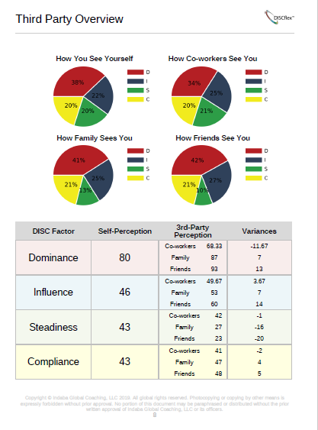
Third Party Perception
Notes:
The Third Party Perception section is the only part of the report that looks at how other people view your behavior.

Slide 22
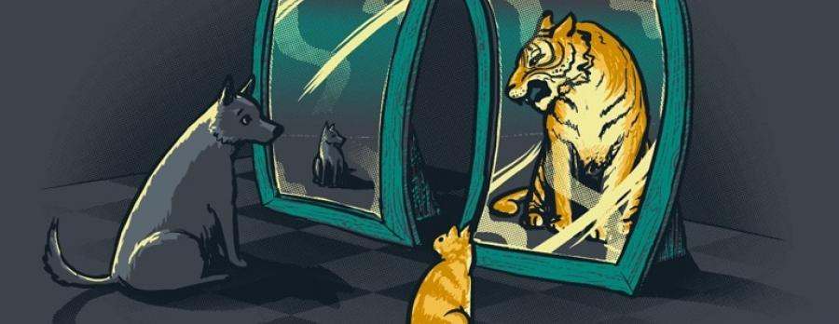
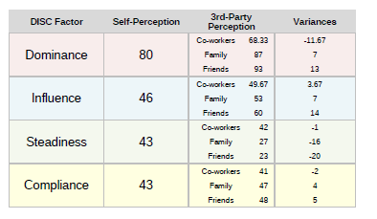
Third Party perception
Find out how other people perceive your behavior.
This section of the report provides awareness of how other people view your behavior.
Is there a difference between how others see your behavior than how you see yourself?
Are you flexing your behavior in different circles or are you consistent?
The data can be used for great conversations around ones behavior.
Notes:
Results can be influenced by:
*How long you have known someone.
*Perceived level of authority (are they your boss, subordinate, peer?)
*How comfortable you are in different groups of people (new job/relationship).

Slide 23
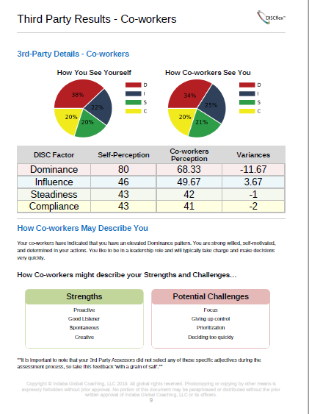
Third Party Details
Notes:
We have individual pages for co-workers, family, and others in relation to how they see you vs your self-perception.

Slide 24
Invite 3rd party assessors
Log into your DISCflex Account Dashboard and click “Invite More 3rd Party Guests”
Notes:
Step 1 – Login to their user account
Step 2 – Click the course list
Step 3 – Select the DISCflex Program they completed
Step 4 – Click the button outline in red above.
In case anyone asks how to invite 3rd party assessors.

Slide 25
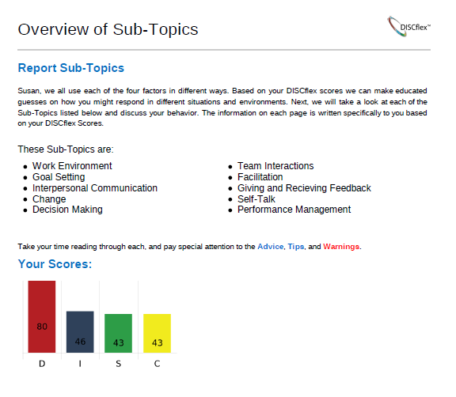
Sub-Topics
Report sub-topics:
The rest of this Report is going to cover specialized Sub-Topics that are written Just For You!
Information is based on your individual factor scores and highly personalized.
Pay special attention to Advice and Warnings
Take notes and be sure to highlight areas that you really want to work to improve on.
Re-visit this report often to see how you well you have learned to flex your behavior and meet your goals.
Notes:
The introduction to your behavior page recaps your DISC Pattern, the information on DISC factors and provides you with the sub-topics of this report. The sub-topics provide personalized coaching tips and bewares based on your DISC factor scores. Sub-Topics are meant as reference materials to review at the appropriate time.

Slide 26
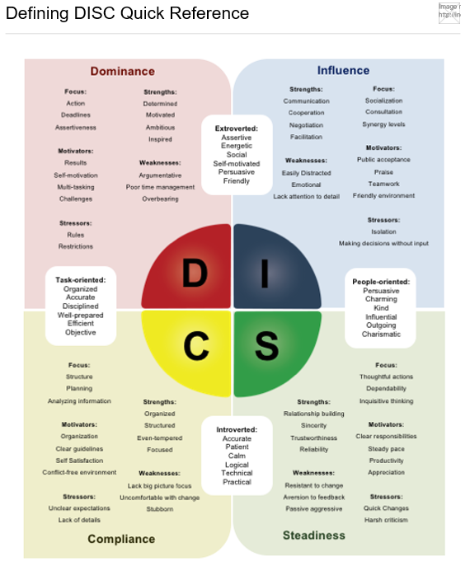
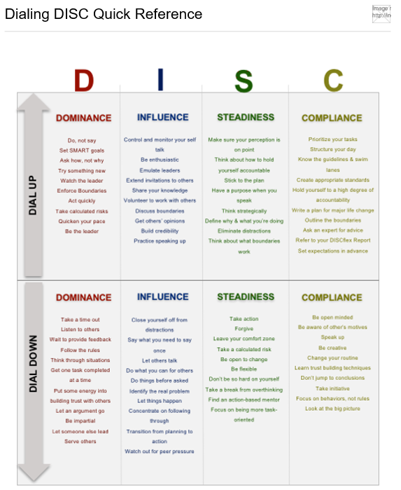
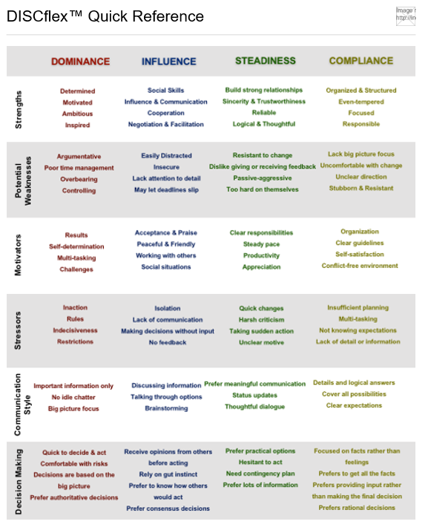
Cheat Sheets
At the end of your DISCflex Report you will find Reference Guides to help you identify behaviors in others as well as practice flexing your behavior.
Notes:
Use your cheat sheets to Learn More about the different style and to practice flexing your behavior!

Slide 27
Applying DISC
Notes:
This Webinar we will discuss how you can apply DISC to your everyday work.

Slide 28
Defining DISC
Recap:
Dominance: Your need for control and your source of ambition. Whenever you are feeling self-motivated, you are using your 'D' factor.
Influence: Your need for communication and your source of persuasion. Whenever you are feeling talkative, you are using your 'I' factor.
Steadiness: Your need for planning and your source of thoughtfulness. When you are being strategic or go out of your way to help someone, you are using your 'S' factor.
Compliance: Your need for structure and your source of organization. When you become extremely focused on completing your tasks, you are using your 'C' factor.

Slide 29
Dominance
Dominance: Your need for control and your source of ambition. Whenever you are feeling self-motivated, you are using your 'D' factor.
Generally, how do you recognize High Dominance?
What behavior will you notice?
What do they say to themselves inside their head?
The level matters!
Strengths | Motivators | Focus | Decision Making
Determined Motivated Ambitious Visionary | Results Authority Multi-Tasking Challenges | Efficiency Deadlines Assertiveness | Quick to Decide & Act Comfortable with Risks Authoritative Decisions
Notes:
Show this slide when the dominance factor car idea is being discussed.

Slide 30
Influence
Influence: Your need for communication and your source of persuasion. Whenever you are feeling talkative, you are using your 'I' factor.
Generally, how do you recognize High Influence?
What behavior will you notice?
What do they say to themselves inside their head?
The level matters!
Strengths | Motivators | Focus | Decision Making
Communication Cooperation Negotiation Facilitation | Public Acceptance Praise Teamwork Friendly Interaction | Socialization Consultation Synergy Levels | Feedback From Others Consensus Decisions What is Popular
Notes:
Show this slide when the influence factor car idea is being discussed.

Slide 31
Steadiness
Steadiness: Your need for planning and your source of thoughtfulness. When you are being strategic or go out of your way to help someone, you are using your 'S' factor.
Generally, how do you recognize High Steadiness?
What behavior will you notice?
What do they say to themselves inside their head?
The level matters!
Strengths | Motivators | Focus | Decision Making
Relationship Building Sincerity Trustworthiness Reliability | Clear Responsibilities Steady Pace Team Atmosphere Peer Recognition | Thoughtful Actions Dependability Inquisitive Thinking | Prefer Practical Options Hesitant to act/decide Need Contingency Plan
Notes:
Show this slide when the steadiness factor car idea is being discussed.

Slide 32
Compliance
Compliance: Your need for structure and your source of organization. When you become extremely focused on completing your tasks, you are using your 'C' factor.
Generally, how do you recognize High Compliance?
What behavior will you notice?
What do they say to themselves inside their head?
The level matters!
Strengths | Motivators | Focus | Decision Making
Organized Structured Even-Tempered Focused | Organization Clear Guidelines Individual Recognition Conflict-Free Environment | Structure Planning Analyzing Information | Facts Over Feelings Prefer Rational Decisions Fully Informed Decisions
Notes:
Show this slide when the compliance factor car idea is being discussed.

Slide 33
Group Activity
Break up into 4 separate groups
Assign each group 1 of the 4 DISC factors
Group 1 | Group 2 | Group 3 | Group 4
Dominance | Influence | Steadiness | Compliance
Notes:
Give the group or individuals time to discuss and then they will present their ideas. You will pop up the next 4 slides when each factor is being discussed. Please allow time for brainstorming and debriefing.

Slide 34
Group Activity
Strengths | Motivators | Focus | Decision Making
Determined Motivated Ambitious Visionary | Results Authority Multi-Tasking Challenges | Efficiency Deadlines Assertiveness | Quick to Decide & Act Comfortable with Risks Authoritative Decisions
D
Your group will go car shopping as a person with a very HIGH level of your assigned factor. You must answer all of the following questions about your car shopping experience.
What is the first step you would take?
What type of features would be most important?
How many dealerships would you contact/visit?
What car you would buy?
Strengths | Motivators | Focus | Decision Making
Communication Cooperation Negotiation Facilitation | Public Acceptance Praise Teamwork Friendly Interaction | Socialization Consultation Synergy Levels | Feedback From Others Consensus Decisions What is Popular
I
Strengths | Motivators | Focus | Decision Making
Relationship Building Sincerity Trustworthiness Reliability | Clear Responsibilities Steady Pace Team Atmosphere Peer Recognition | Thoughtful Actions Dependability Inquisitive Thinking | Prefer Practical Options Hesitant to act/decide Need Contingency Plan
S
Strengths | Motivators | Focus | Decision Making
Organized Structured Even-Tempered Focused | Organization Clear Guidelines Individual Recognition Conflict-Free Environment | Structure Planning Analyzing Information | Facts Over Feelings Prefer Rational Decisions Fully Informed Decisions
C
Notes:
Give the group or individuals time to discuss and then they will present their ideas. You will pop up the next 4 slides when each factor is being discussed. Please allow time for brainstorming and debriefing.
Recommended approach: count off- 1-4. We do not want to have people only learning about their own profile.
Webinar- Use Breakout Rooms
First Step- (Go to dealership, research, Consult others, etc)
Features- (safety, warranty, Bluetooth, rims, Horse Power etc)
Buy at first dealership or shop around? Online? In person?
Car- For speed? Safety? Flashy? Reliability? Price conscious? Eco-Friendly?

Slide 35
Group Debrief- Dominance
What is the first step you would take?
What type of features would be most important?
How many dealerships would you contact/visit?
What car you would buy?
Strengths | Motivators | Focus | Decision Making
Determined Motivated Ambitious Visionary | Results Authority Multi-Tasking Challenges | Efficiency Deadlines Assertiveness | Quick to Decide & Act Comfortable with Risks Authoritative Decisions
Notes:
Show this slide when the dominance factor car idea is being discussed.

Slide 36
Group Debrief- Influence
What is the first step you would take?
What type of features would be most important?
How many dealerships would you contact/visit?
What car you would buy?
Strengths | Motivators | Focus | Decision Making
Communication Cooperation Negotiation Facilitation | Public Acceptance Praise Teamwork Friendly Interaction | Socialization Consultation Synergy Levels | Feedback From Others Consensus Decisions What is Popular
Notes:
Show this slide when the influence factor car idea is being discussed.

Slide 37
Group Debrief- Steadiness
What is the first step you would take?
What type of features would be most important?
How many dealerships would you contact/visit?
What car you would buy?
Strengths | Motivators | Focus | Decision Making
Relationship Building Sincerity Trustworthiness Reliability | Clear Responsibilities Steady Pace Team Atmosphere Peer Recognition | Thoughtful Actions Dependability Inquisitive Thinking | Prefer Practical Options Hesitant to act/decide Need Contingency Plan
Notes:
Show this slide when the steadiness factor car idea is being discussed.

Slide 38
Group Debrief- Compliance
What is the first step you would take?
What type of features would be most important?
How many dealerships would you contact/visit?
What car you would buy?
Strengths | Motivators | Focus | Decision Making
Organized Structured Even-Tempered Focused | Organization Clear Guidelines Individual Recognition Conflict-Free Environment | Structure Planning Analyzing Information | Facts Over Feelings Prefer Rational Decisions Fully Informed Decisions
Notes:
Show this slide when the compliance factor car idea is being discussed.

Slide 39
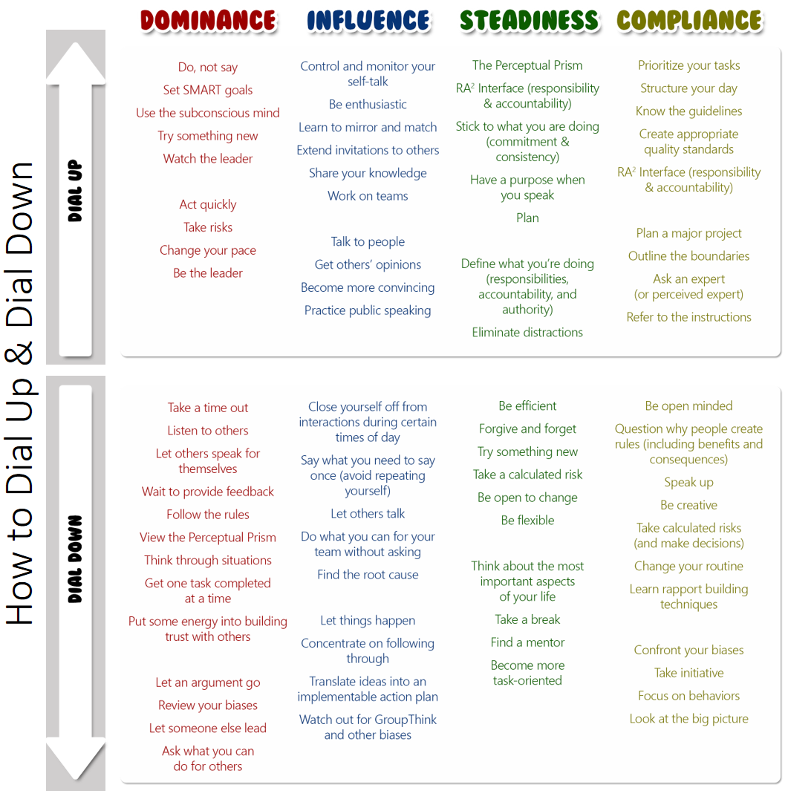
Dialing Up and Down Your Behavior
Notes:
This webinar will focus on being able to situationally flex your behavior.

Slide 40
Defining DISC
Let’s Review Each of The 4 DISC Factors
Dominance: Your need for control and your source of ambition. Whenever you are feeling self-motivated, you are using your 'D' factor.
Influence: Your need for communication and your source of persuasion. Whenever you are feeling talkative, you are using your 'I' factor.
Steadiness: Your need for planning and your source of thoughtfulness. When you are being strategic or go out of your way to help someone, you are using your 'S' factor.
Compliance: Your need for structure and your source of organization. When you become extremely focused on completing your tasks, you are using your 'C' factor.
Notes:
Read the slide.

Slide 41
Dominance
Dominance: Your need for control and your source of ambition. Whenever you are feeling self-motivated, you are using your 'D' factor.
DIAL UP
Dial Down
y
What are some ways you can Dial Up your Dominance?
When may this be applicable?
What are some ways you can Dial Down your Dominance?
When may this be applicable?
Notes:
Read the slide. Allow time for discussion.

Slide 42
Dominance
Scenarios in which your dominance factor is important- Leadership Roles, Getting Results, Making Decisions
DIAL UP
Dial Down
Set SMART Goals
Try something new
Act quickly
Take risks
Be the leader
Take a time out
Listen to others
Wait to provide feedback
Follow the rules
Complete one task at a time
Notes:
Use this slide for answers to discussion.

Slide 43
Influence
Influence: Your need for communication and your source of persuasion. Whenever you are feeling talkative, you are using your 'I' factor.
Dial Up
Dial Down
What are some ways you can Dial Up your Influence?
When may this be applicable?
What are some ways you can Dial Down your Influence?
When may this be applicable?
Notes:
Read the slide. Allow time for discussion.

Slide 44
Influence
Scenarios in which your Influence factor is important- Communicating, Motivating, Working with others
Dial Up
Dial Down
Be enthusiastic
Extend invitations to others
Share your knowledge
Get others' opinions
Practice public speaking
Work alone
Let others talk
Focus
Let things happen
Concentrate on following through
Notes:
Use this slide for answers to discussion.

Slide 45
Steadiness
Steadiness: Your need for planning and your source of thoughtfulness. When you are being strategic or go out of your way to help someone, you are using your 'S' factor.
Dial Up
Dial Down
What are some ways you can Dial Up your Steadiness?
When may this be applicable?
What are some ways you can Dial Down your Steadiness?
When may this be applicable?
Notes:
Read the slide. Allow time for discussion.

Slide 46
Steadiness
Scenarios in which your Steadiness factor is important- Strategizing, Building Relationships, Planning
Dial Up
Dial Down
Focus on planning
Stick to the plan
Speak with purpose
Focus on building trust
Eliminate distractions
Be efficient
Forgive and forget
Try something new
Take a calculated risk
Be flexible
Notes:
Use this slide for answers to discussion.

Slide 47
Compliance
Compliance: Your need for structure and your source of organization. When you become extremely focused on completing your tasks, you are using your 'C' factor.
Dial Up
Dial Down
What are some ways you can Dial Up your Compliance?
When may this be applicable?
What are some ways you can Dial Down your Compliance?
When may this be applicable?
Notes:
Read the slide. Allow time for discussion.

Slide 48
Compliance
Scenarios in which your Compliance factor is important- Organizing, Following the rules, Accuracy
Dial Up
Dial Down
Prioritize your tasks
Structure your day
Know the guidelines
Outline the boundaries
Refer to the instructions
Be open-minded
Speak up
Be creative
Take the initiative
Look at the big picture
Notes:
Use this slide for answers to discussion.

Slide 49
Sub-factor Spectrums
Efficiency Friendliness
Self-motivation Patience
Independence Cooperativeness
Enthusiasm Thoughtfulness
Self-confidence Accuracy
Persistence Sensitivity
Notes:
Goal- Be able to use all 12 sub-factors situationally. Notice we said SITUATIONALLY, not SIMULTANIOUSLY.

Slide 50
Where Are you on Each Spectrum?
Use your DISC Report to locate your DISC Factor Scores.
For each spectrum look a the two factors and which ever is bigger will be your driving sub-factor. This will be your natural tendency. The bigger the gap between scores the more energy it will take to dial up your opposing sub-factor.
Example:
Jane Doe has a dominance score of 90 and an Influence factor score of 25. She has a 65 point gap. Her driving sub factor is the Dominance over Influence we call this Efficiency. Her opposing sub factor is Friendliness which is when someone’s influence factor is above their dominance factor.
What we learn is, Jane Doe will thrive in doing things efficiently. What she will need to work on is dialing her dominance down and influence up when she wants to be friendly. A 65 point gap make this harder for her to do as she in not naturally using her influence factor. The smaller the gap in-between factors the easier and less stressful it will be to display that sub factor.
Notes:
Informational slide so that you understand where sub-factors come from and how to find them.

Slide 51
DISC Sub-factors™
Efficiency
Friendliness
When Dominance is greater than Influence, you have the…
Efficiency Sub-factor™
Up
When Influence is greater than Dominance, you have the…
Friendliness Sub-factor™
Up
+50
Rushed
Tunnel Vision
Efficient
Laser Focused
Direct
Assertive
Performance Driven
Productive
Effective Communication
Inclusive
Social
Accepting
Kind
Friendly
Passive Leadership
Insecurity
+40
High D
Low I
+30
+20
+10
Even
Balanced
Down
+10
+20
Direct and assertive
Finish work very quickly
Rarely or never miss deadlines
May appear willing to do whatever it takes to get the job done
+30
Love communication
Extrovert
Good at making small talk
Get along well with others
High I
Low D
+40
+50
Up
Up
Notes:
***These notes are for preparation and understanding of the slides to follow- It is best to understand these notes and use a shorthand version of these notes for your actual presentation***
Here we are examining the D factor vs the I factor. We refer to this Sub-Factor Spectrum as Efficiency vs Friendliness.
(left side) When someone’s Dominance Score is greater than their Influence Score, they will tend to be more Efficient than Friendly.
(right side) When someone’s Influence Score is greater than their Dominance Score, they will tend to be more Friendly than Efficient.
Both Efficiency and Friendliness are great strengths to use, but must be used at the appropriate time.
The bigger the gap between the 2 scores, the more heavily a person will tend to lean on their Driving Sub-Factor and the more energy or focus it will take to shift to their opposing Sub-Factor.
****Click Slide to Highlight grey “balanced” box****
(*middle of screen*) If the 2 factor scores are close to or exactly even then the person is likely to display a good balance between the 2 sub-factors.
Someone who has a good balance between Efficiency and Friendliness will be productive and communicate effectively. It should be relatively easy for this person to shift back and forth between being efficient and friendly.
****Click slide to highlight top (RED) box****
Here we see someone with a High D and Low I (30-40 point gap) would tend to be much more Efficient than Friendly. This person would need to consciously “Dial Up” their Influence (Friendliness) and “Dial Down” their Dominance (Efficiency) in situations that require a more friendly approach. This will initially take a lot of effort, but the more they practice “Dialing Up” their Influence (Friendliness) the easier it will become to shift between the 2 sub-factors and display the appropriate behavior.
****Click to highlight bottom (Blue) box****
Here we see someone with a High I and Low D (30-40 point gap) would tend to be much more Friendly than Efficient. This person would need to consciously “Dial Up” their Dominance (Efficiency) and “Dial Down” their Influence (Friendliness) in situations that require a more Efficient approach. Again, this will initially take a lot of effort, but the more they practice “Dialing Up” their Dominance (Efficiency) the easier it will become to shift between the 2 sub-factors and display the appropriate behavior.
Please note: There is such a thing as Dialing Up “Too high”. As you can see, if we dial up our Dominance too high and move PAST efficiency and become too task oriented we can become Rushed and have Tunnel Vision. If we Dial Up our Influence too high and focus too much on being People Oriented we can get to a place of Passive Leadership and Insecurity. The key is to learn how to effectively use both Sub-Factors and identify which is most appropriate for any given situation. Use your Sub-Factor pages from your report to identify your 3 Opposing Sub-Factors. These Opposing Sub-Factors are a good place to start when practicing Flexing Your Behavior.

Slide 52
DISC Sub-factors™
Self-Motivation
Patience
When Dominance is higher than Steadiness, you have the…
Self-Motivation Sub-factor™
Up
When Steadiness is greater than Dominance, you have the…
Patience Sub-factor™
+50
Forceful
Impulsive
Self-Motivated
Assertive
Decisive
Driven
Competitive
Focused
Stable
Easy Going
Composed
Cautious
Hesitant
Patient
Uncertain
Analysis Paralysis
+40
High D
Low S
+30
+20
+10
Even
Balanced
+10
+20
Generally always working on something
Tend to not take extended breaks
Creative or imaginative
+30
High S
Low D
Introvert
Rarely make rash decisions
Handle stressful situations by waiting them out
Realistic & positive
+40
+50
Up

Slide 53
DISC Sub-factors™
Independence
Cooperativeness
When Dominance is greater than Compliance, you have the…
Independence Sub-factor™
When Compliance is greater than Dominance, you have the…
Cooperativeness Sub-factor™
Up
+50
Rule Breaker
Permission Taker
Independent
Take Charge
Assertive
Self-Reliant
Competitive
Effective
Team Player
Easy Going
Respectful
Compliant
Obedient
Cooperative
Complacent
Submissive
+40
High D
Low C
+30
+20
+10
Even
Balanced
+10
+20
Prefer to work alone
Create their own rules
Typically remain neutral in the affairs of others
Goal-oriented
+30
Easy to work with
Enjoy helping out
Focus on policies and procedures
Naturally build positive relationships with others
High C
Low D
+40
+50
Up

Slide 54
DISC Sub-factors™
Enthusiasm
Thoughtfulness
When Influence is greater than Steadiness, you have the…
Enthusiasm Sub-factor™
Up
When Steadiness is greater than Influence, you have the…
Thoughtfulness Sub-factor™
+50
Over Zealous
Idealistic
Enthusiastic
Ambitious
Visionary
Energetic
Goal-Oriented
Tactful
Astute
Attentive
Logical
Accurate
Considerate
Thoughtful
Cautious
Overthinking
High I
Low S
+40
+30
+20
+10
Even
Balanced
+10
+20
Outgoing & extroverted
Positive attitude
Able to keep up with others
Go-getter
+30
High S
Low I
Highly aware of surroundings
Think diligently
Tend to plan for everything
Trust logic over impulse
+40
+50
Up

Slide 55
DISC Sub-factors™
Self-confidence
Accuracy
When Influence is greater than Compliance, you have the…
Self-confidence Sub-factor™
Up
When Compliance is greater than Influence, you have the…
Accuracy Sub-factor™
+50
Delusions of Grandeur
Arrogant
Self-Confident
Presumptuous
Quick to Act
Poised
Effective
Meticulous
Thoughtful
Careful
Observant
Alert
Attentive
Accurate
Careful
Afraid to Make Mistakes
High I
Low C
+40
+30
+20
+10
Even
Balanced
+10
+20
Extrovert
Rarely doubt themselves
Able to easily open a conversation
Very comfortable in social situations
+30
High C
Low I
Take their time
Pay attention to details
Easily find errors
Prefer to understand the situation completely before making a decision
+40
+50
Up

Slide 56
DISC Sub-factors™
Persistence
Sensitivity
When Steadiness is greater than Compliance, you have the…
Persistence Sub-factor™
Up
When Compliance is greater than Steadiness, you have the…
Sensitivity Sub-factor™
+50
Stubborn
Pushy
Persistent
Diligent
Resilient
Encouraged
Determined
Focused
Thoughtful
Perceptive
Instinctual
Rules Oriented
Understanding
Sensitivity
Indecisive
Analysis Paralysis
High S
Low C
+40
+30
+20
+10
Even
Balanced
+10
+20
Keep at their work despite the difficulties they may encounter
Predictable
Determined
Rarely get discouraged
+30
High C
Low S
Does NOT mean that you are easily upset
Highly aware of rules
Contingency Planning
Sensitive to details
+40
+50
Up

Slide 57
Team Behavior Report
Notes:
During the team behavior report section you will take them through their actual team report. The following slides are meant for reference in helping you understand what is in the report.
Note to instructors: Slides on Team Leaders are here for your information, these slides would not be used with the group.

Slide 58
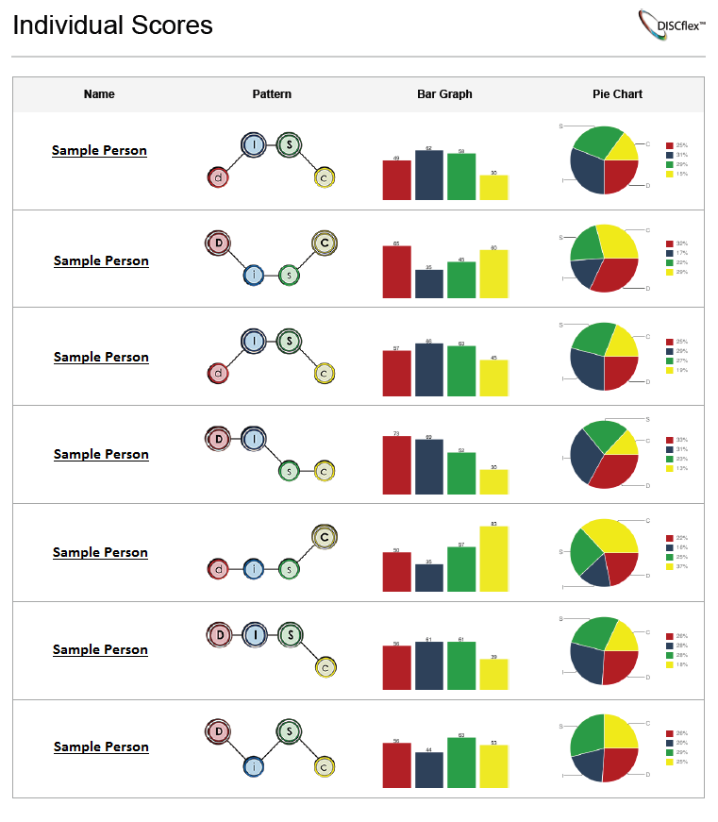
Individual Scores
1
2
3
4
Micro Level
Names of individuals
Each person’s DISCflex™ Pattern
Bar Graph with individual’s score for each factor
Pie Chart with percentage to total of each factor
Notes:
Read slide and locate corresponding numbers.

Slide 59
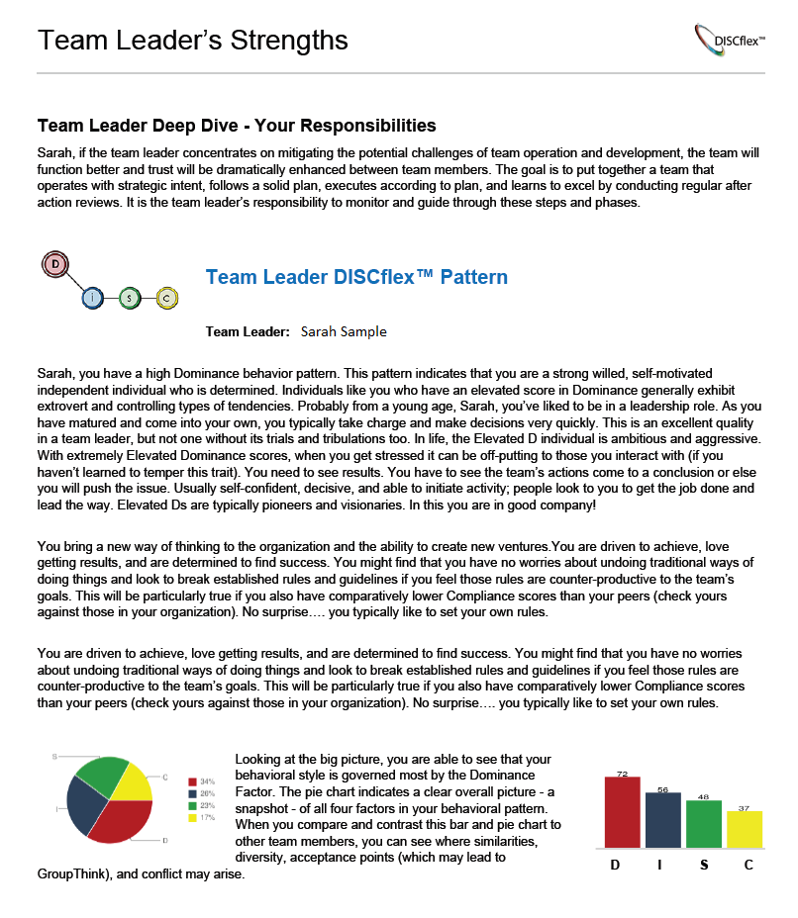
Team leader strengths
1
Team leader’s responsibilities
Team Leader’s DISCflex™ Pattern
Personalized message for the team leader
Team Leader’s individual factor scores
Team Leader’s DISCflex™ Pie Chart
2
3
4
5
Notes:
Read slide and locate corresponding numbers.

Slide 60
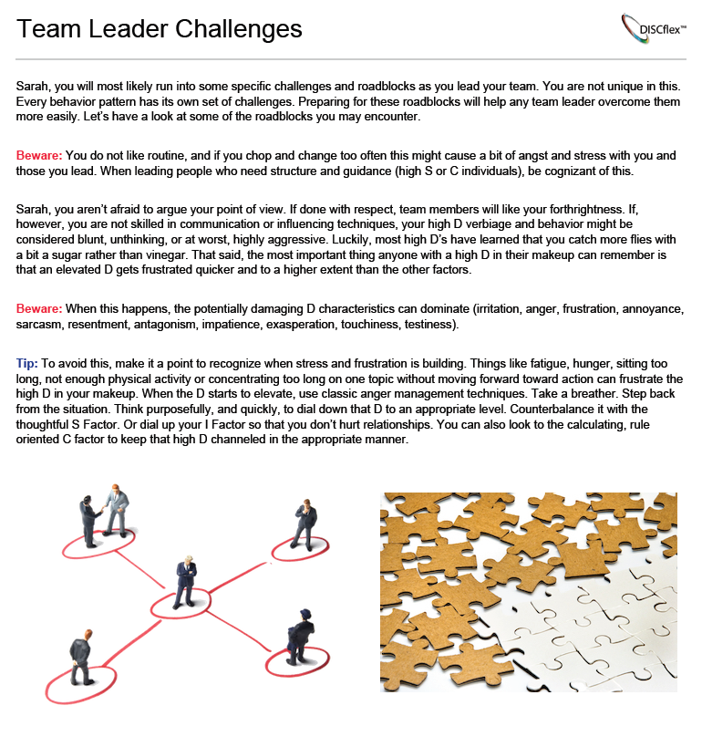
Team Leader Challenges
1
Specific information about your chosen team leader’s potential challenges
Team Leader BEWARES give you and the team leader feedback about the challenges they may face based on their behavior profile
Team Leader TIPS offer advice on how to deal with these challenges as they come along to be a more effective leader
2
3
Notes:
Read slide and locate corresponding numbers.

Slide 61
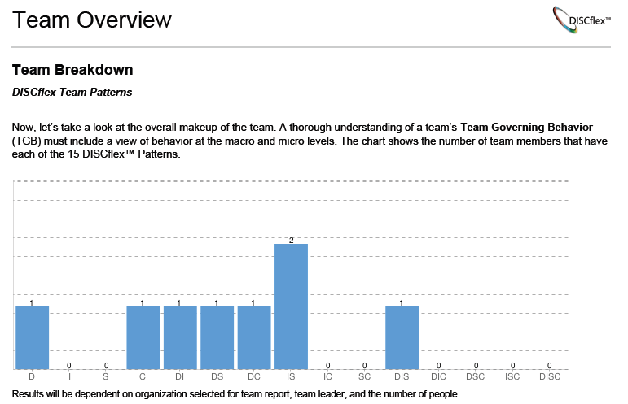
Team Breakdown
Macro Level
Number of people who have each DISCflex™ Pattern
Bars give you a visual of the magnitude of Patterns relative to each other providing a snapshot of areas to monitor.
Behavioral skills gaps are highlighted for your team.
2
1
3
Notes:
Read slide and locate corresponding numbers.

Slide 62
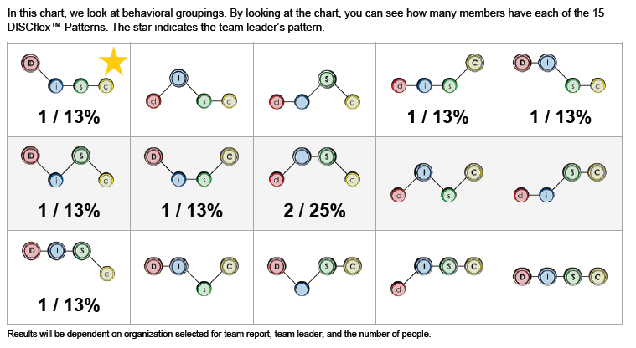
Team Breakdown
Macro Level
Team Leader designated with a Gold Star
Number of people who have each DISCflex™ Pattern
PERCENTAGE of people who have each DISCflex™ Pattern relative to the whole team
Find out which Patterns you are missing
*
1
2
3
4
Notes:
Read slide and locate corresponding numbers.

Slide 63
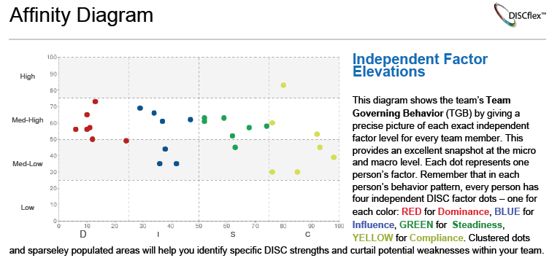
Affinity diagram
Micro Level
Each dot represents one person’s factor score (there are 4 for each individual)
Dots are color coded by factor
1
2
Notes:
Read slide and locate corresponding numbers.

Slide 64
Affinity diagram
Macro Level
Clusters show your teams dominant traits
Identify clusters as HIGH or LOW and match with the clusters with corresponding Tips pages.
1
2
High Clusters:
Dominance
Influence
Steadiness
Low Clusters:
Compliance
Notes:
Read slide and locate corresponding numbers.

Slide 65
Questions about your team that promote discussion:
Are they a high energy team?
Are they a team that values relationships and inclusiveness?
Do they appear to be a team that prefers to be precise?
Do they follow the rules?
Is loyalty held in high regard?
What behaviors rule over their team decision making? Or over how team members interact with others?
Which overriding behaviors emerge during stress?
During brainstorming sessions, or when the team executes their responsibilities, what typically happens in team meetings?
Do they hang out with each other and build friendships? Or does the team function more like a group of individuals who prefer to go about their individual responsibilities without too much interaction than a closely-knit group?
Notes:
These questions are in the report. Use them for a group discussion about the team’s tendencies. How does the group function? How can it improve?

Slide 66
9 Steps of A Highly Successful Team
6) Communicate the action plan
7) Execute the plan
8) Control and revise the plan
9) Conduct an after action review
Articulate team vision
Move from "Have to Do" to SMART Goals
Conduct a situational analysis
Derive the strategy
Develop the action plan
Notes:
The Team behavior report will take the team through the 9 steps of a highly successful team. Each step will have useful factors and tips for driving your team for success.

Slide 67
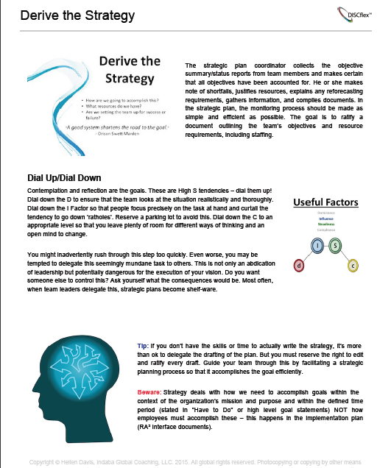
Cheat Sheets components
1
Cheat Sheet for each of the “9 Fundamental Operational Steps of High Performance Teams”
Useful Factor for each step
Dial Up and Dial Down advice for each step
Tips and Bewares for each step
3
2
4
Notes:
Read slide- match with numbers

Slide 68
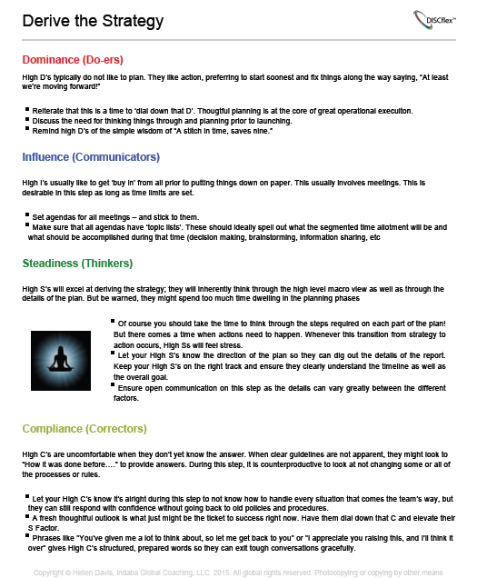
Cheat Sheets Components
1
Advice for High D
Advice for High I
Advice for High S
Advice for High C
2
3
4
Notes:
Each of the 9 steps will have tips on how to cooperate with the different profiles.

